Slide 1
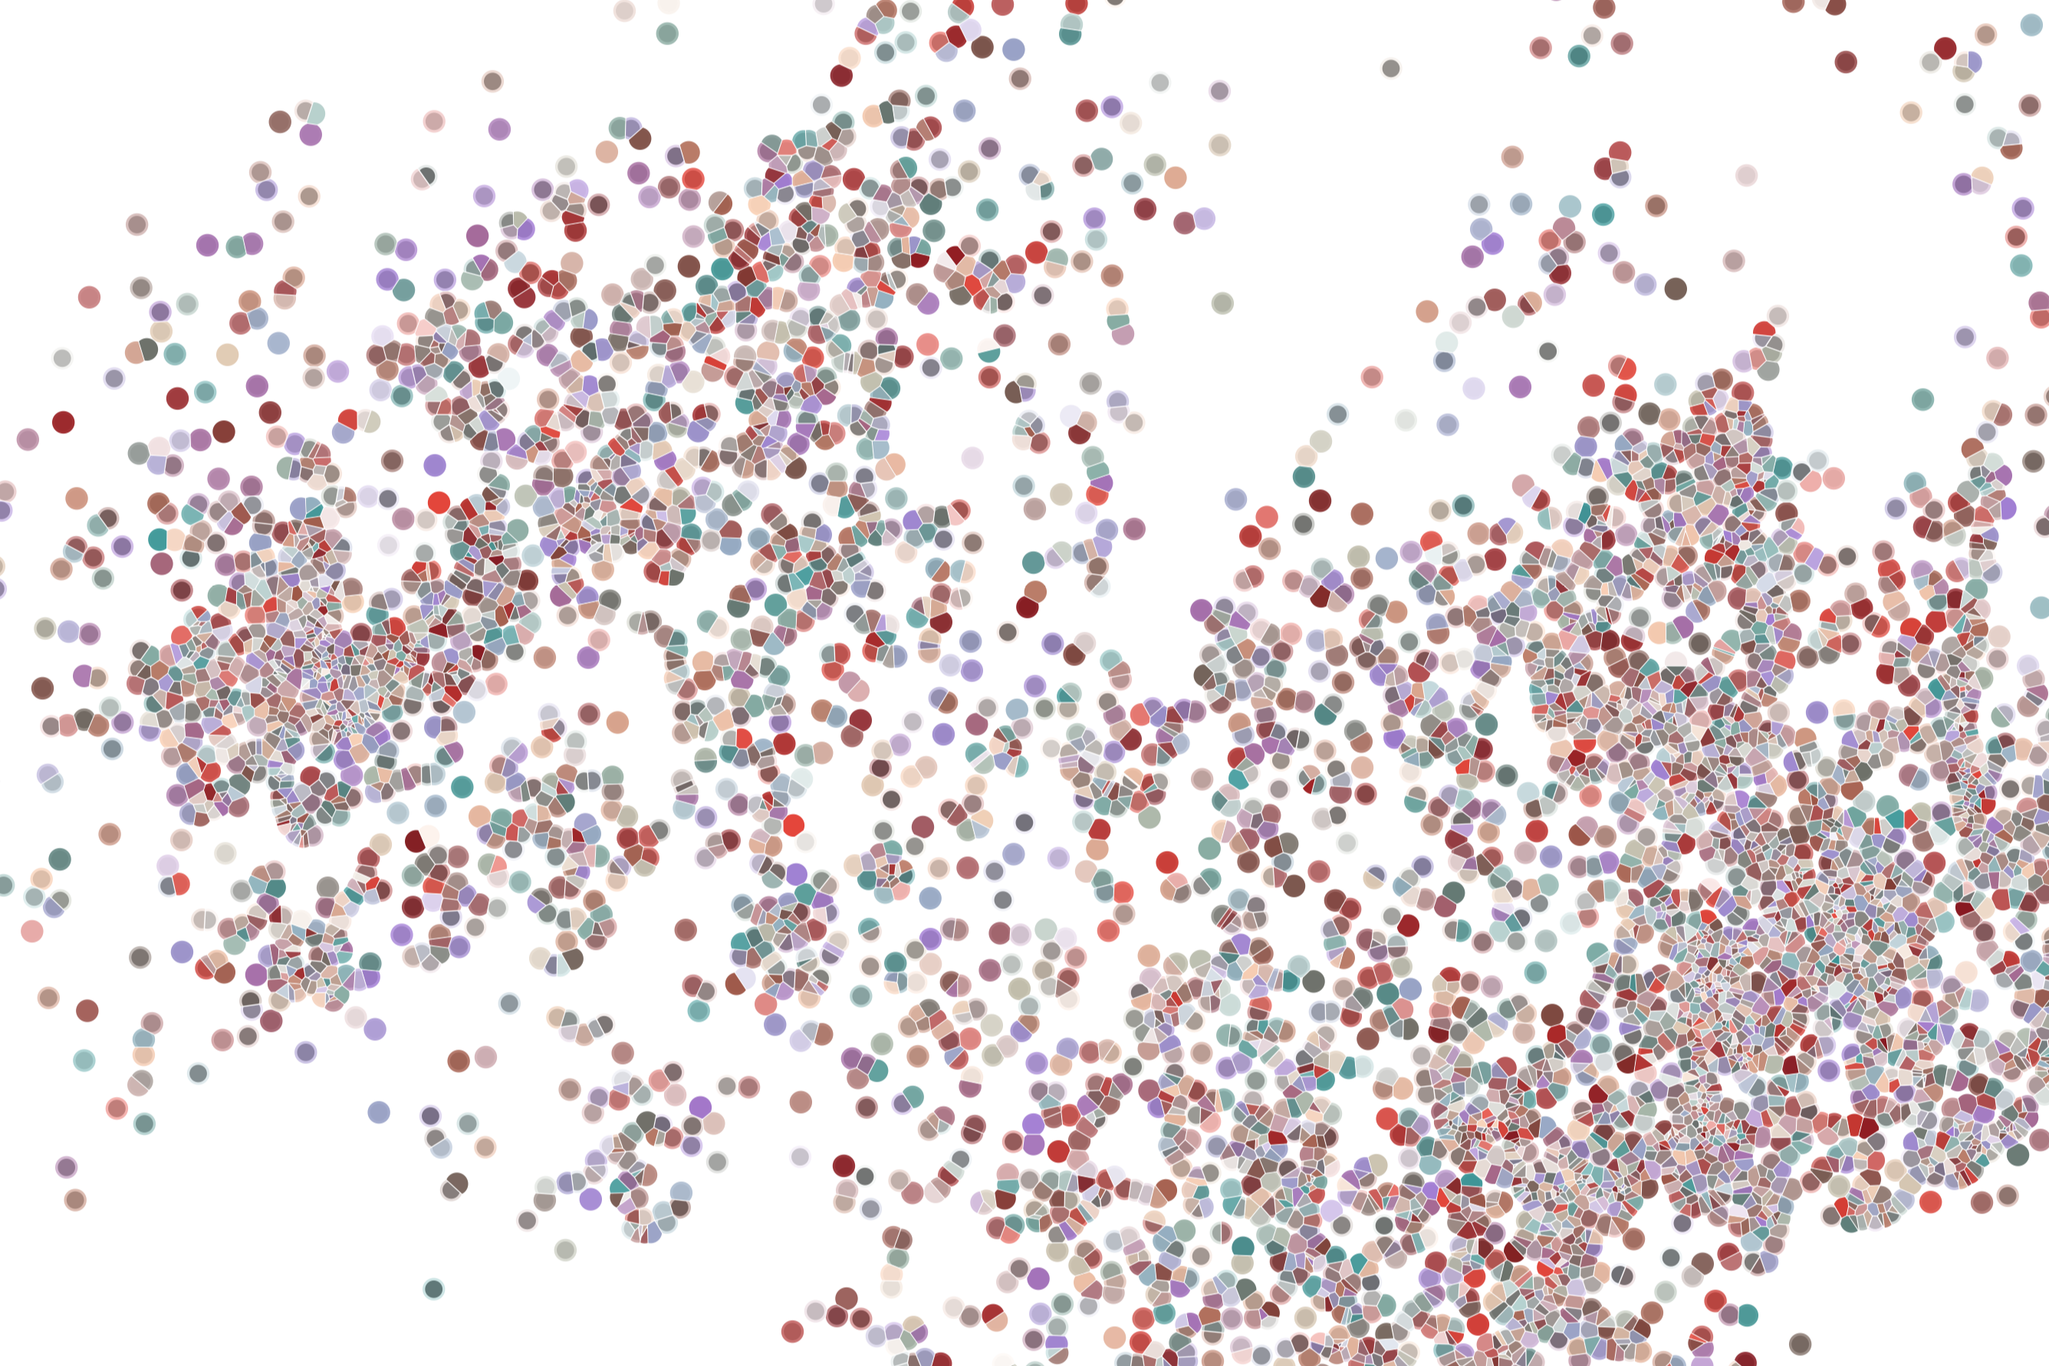
R/Bioconductor 101
Physalia course 2022
Instructor: Jacques Serizay
Notes:
Hello everybody and thank you for attending my presentation. I am going to talk about the project I recently started working on in the Spassky and Koszul labs, both located in Paris. This project focuses on the unusual cooption of the mitotic machinery to drive, not cell division but cell differentiation.

Slide 2
R main classes
Vectors

Slide 3
R main classes
Vectors
Defined with c() function

Slide 4
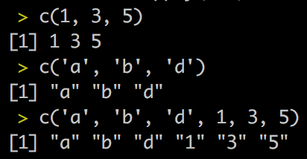
R main classes
Vectors
Defined with c() function
All the elements must be from the same class

Slide 5
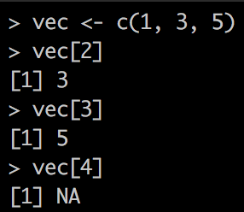
R main classes
Vectors
Defined with c() function
All the elements must be from the same class
Can be subset with […]

Slide 6
R main classes
tibble

Slide 7
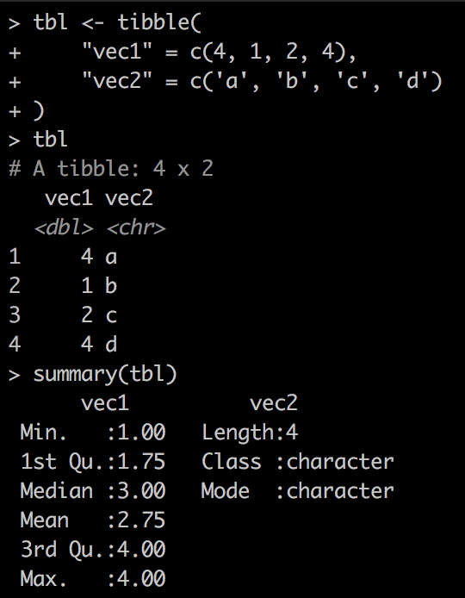
R main classes
tibble
Modern data.frame
Tabular shape
Defined with tibble()

Slide 8
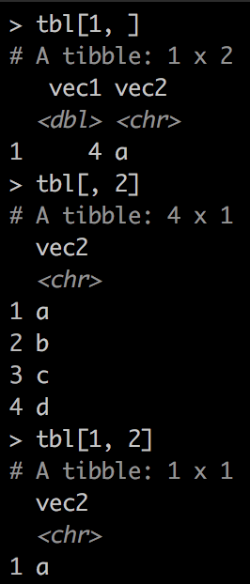
R main classes
tibble
Modern data.frame
Tabular shape
Defined with tibble()
Subset with [ …, …]

Slide 9
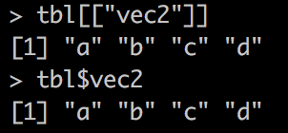
R main classes
tibble
Modern data.frame
Tabular shape
Defined with tibble()
Columns can be accessed to with [[…]] or $

Slide 10
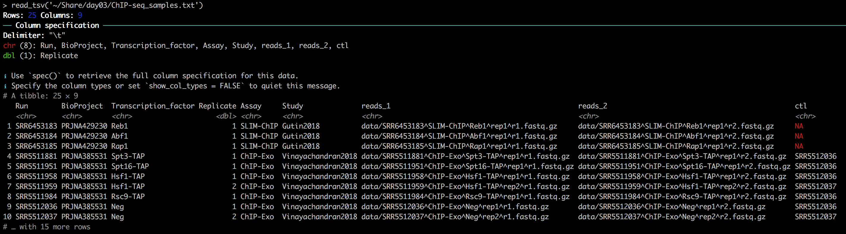
R main classes
Tibbles can be created from tabular files using readr::read_tsv()

Slide 11
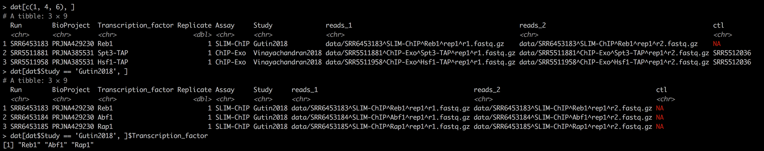
R main classes
dat[ dat$column_name_1 == … , ]
dat[ dat$column_name_1 == … , “column_name_2” ] ]

Slide 12
R main classes
Lists
Defined with list() function
Each element can be whatever object you want
Each element can be named

Slide 13
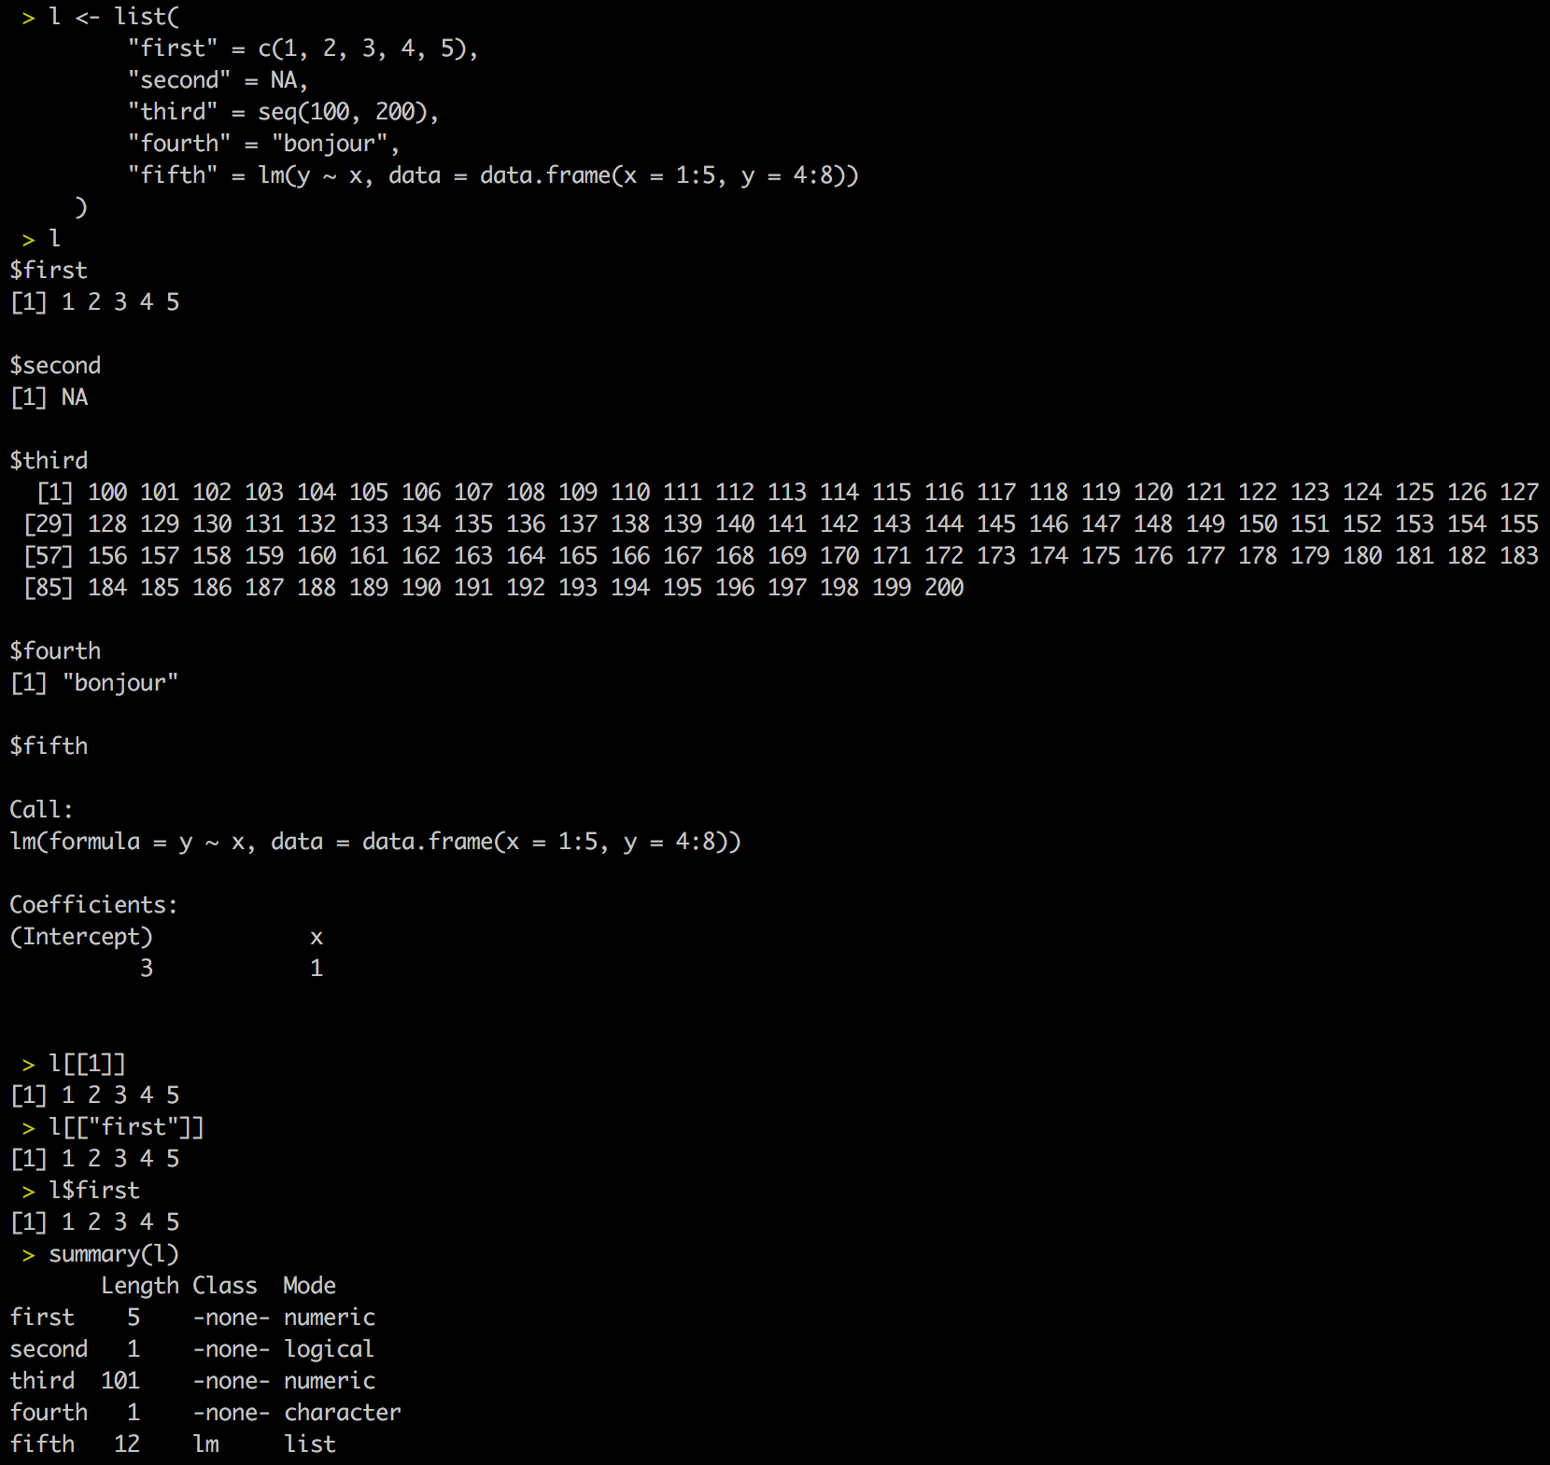
R main classes
Lists

Slide 14
R main classes
Lists

Slide 15
R main classes
Lists

Slide 16
R main classes
Lists

Slide 17
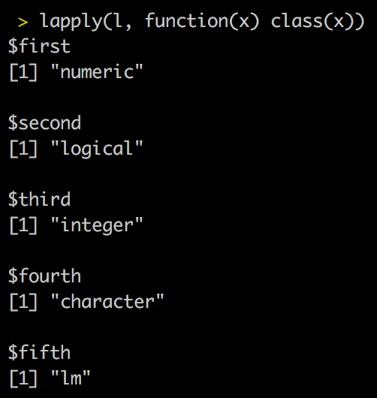
R main classes
You can iterate a function over each element of a list using lapply(list, function(element) {…} )

Slide 18
R main classes
You can iterate a function over each element of a list using lapply(list, function(element) {…} )
This is the equivalent of a for loop, but:
Can be significantly faster
Parallelizable
Does not modify your environment
Returns anything you want in a list
If you are writing a for loop, there are good chances you can switch to lapply()

Slide 19
Vectors vs. list vs. tibbles
Vectors are series of single elements
Lists are nested vectors
Tibbles are a special case of lists where all elements are of the same length

Slide 20
R essential packages
Tidyverse (https://rstudio-education.github.io/tidyverse-cookbook/program.html)
Verb-based ecosystem
dplyr::filter
dplyr::arrange
dplyr::mutate
tidyr::gather
ggplot2 plotting functions
Everything documented/summarized here:
https://www.r-bloggers.com/2020/12/the-tidyverse-in-a-table/

Slide 21
R essential packages
Magrittr’s pipe %>%
Just like a pipe in bash, for R
Very useful in combination with tidyverse’s dplyr for data wrangling

Slide 22
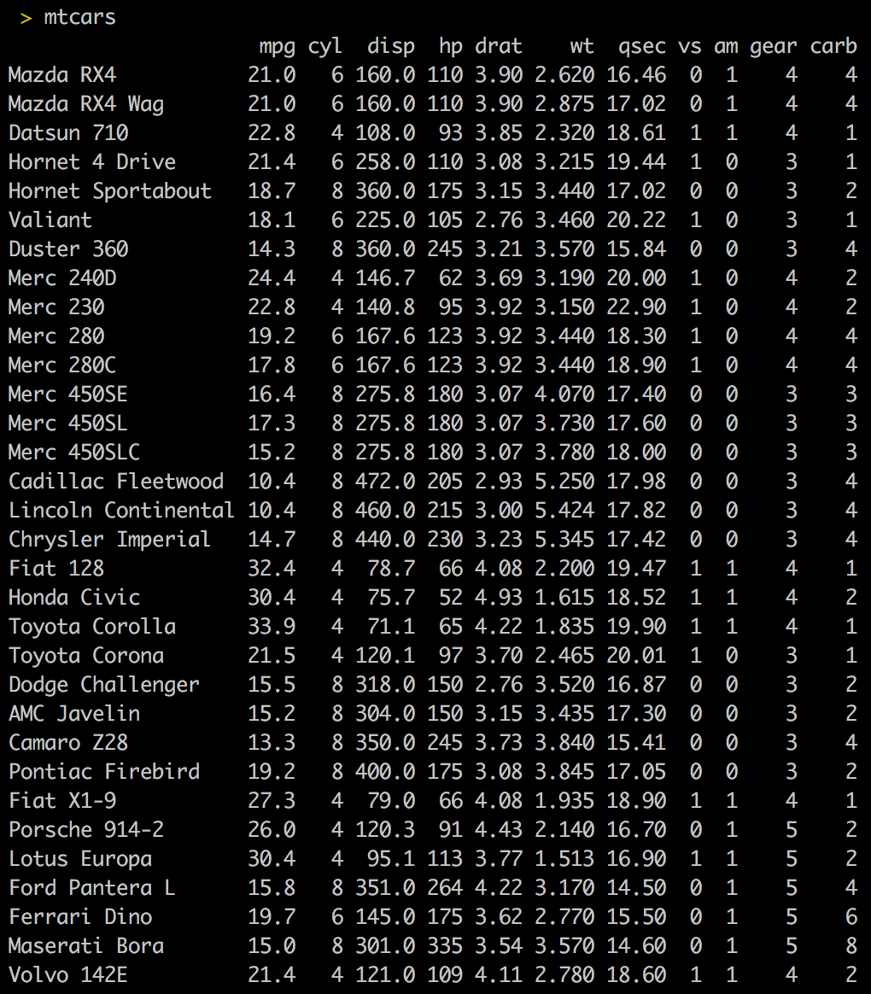
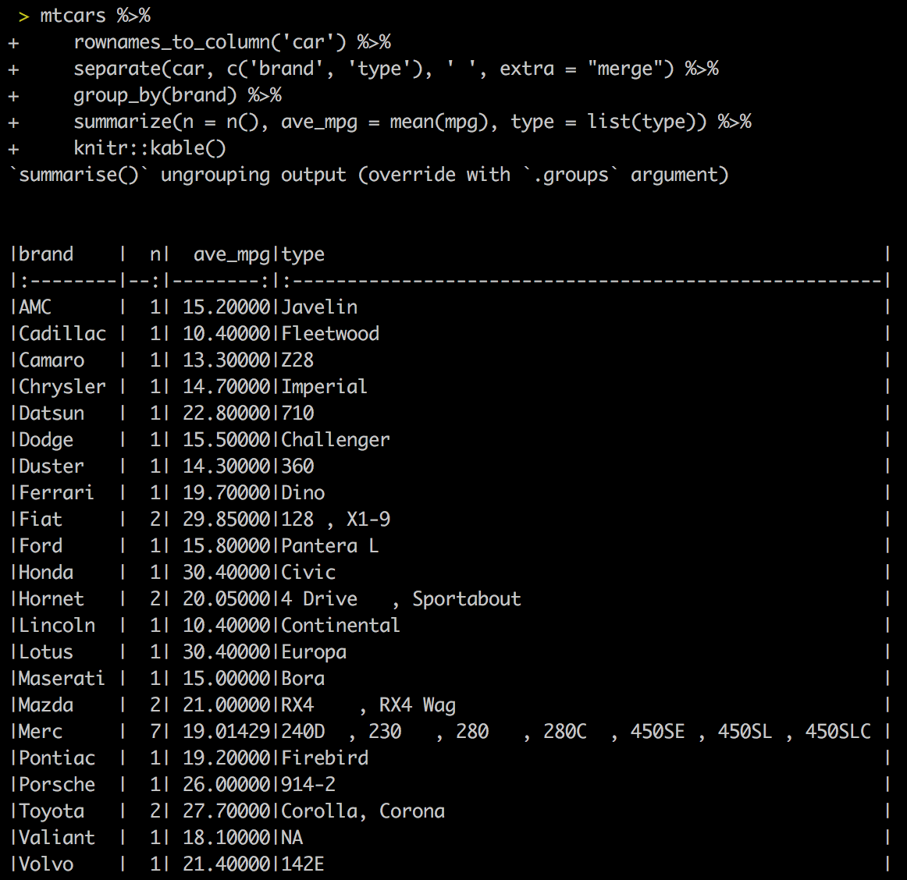
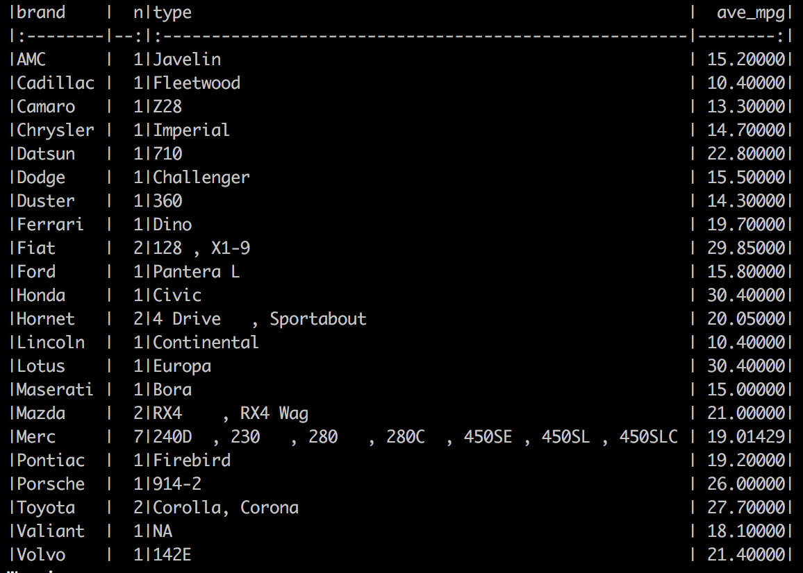
R essential packages

Slide 23
R essential packages
R per se is useful for statistical analyses.
Why do bioinformaticians keep talking about R then?
In other words, how do we unlock the power of R-stats in genomics?

Slide 24
What do you need in bioinformatics to study genomics?
Most common genomic files:
BED format: essentially a set of chromosomal ranges

Slide 25
What do you need in bioinformatics to study genomics?
Most common genomic files:
BED format: essentially a set of chromosomal ranges
BigWig format: essentially veeeeeeeee…eeeeery long numerical vectors

Slide 26
What do you need in bioinformatics to study genomics?
Most common genomic files:
BED format: essentially a set of chromosomal ranges
BigWig format: essentially veeeeeeeee…eeeeery long numerical vectors
Fasta format: letters, letters, letters

Slide 27
What do you need in bioinformatics to study genomics?
Most common genomic files:
BED format: essentially a set of chromosomal ranges
BigWig format: essentially veeeeeeeee…eeeeery long numerical vectors
Fasta format: letters, letters, letters
Others (bam, GFF, …): can usually be described/built on as one of the two options above

Slide 28
Bioconductor
Free, open-source repository
Open development software project
Based primarily on the statistical R programming language
Bioconductor’s releases are bi-annual
Provides tools for the analysis and comprehension of genomic data
https://www.bioconductor.org/

Slide 29
Bioconductor installation
Through BiocManager
As easy as:
install.packages("BiocManager")
BiocManager::install(version = "devel")

Slide 30
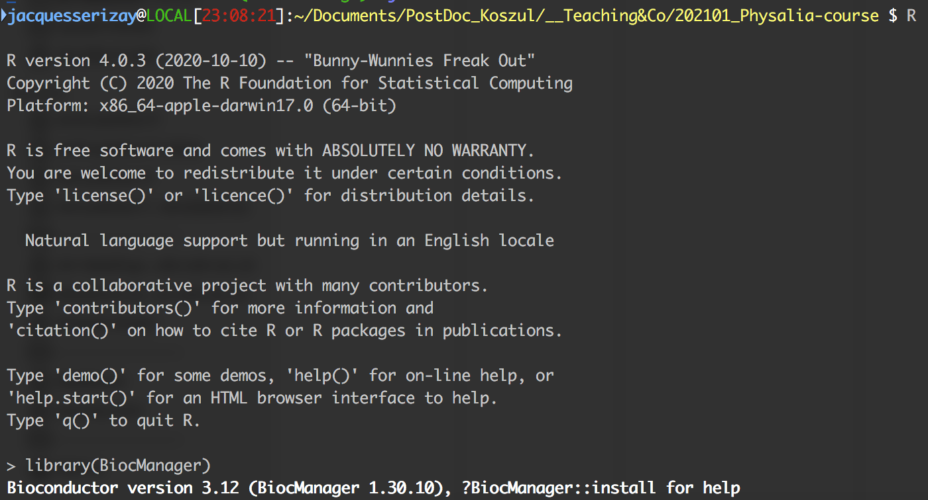
Bioconductor
Integrated in R

Slide 31
Bioconductor version
Integrated in R
Bioconductor’s version depends on your R version

Slide 32
Bioconductor version
Some Bioc packages are restricted to a certain version!

Slide 33
Bioconductor version
To develop an R/Bioc package, developers must be careful of the weather…
https://contributions.bioconductor.org/use-devel.html#use-devel

Slide 34
Bioconductor version
To develop an R/Bioc package, developers must be careful of the weather…
https://contributions.bioconductor.org/use-devel.html#use-devel
Package authors should develop against the version of R that will be available to users when the Bioconductor devel branch becomes the Bioconductor release branch.
R has a ‘.y’ release in x.y.z every year (typically mid-April), but Bioconductor has a .y release (where current devel becomes release) every 6 months (mid-April and mid-October).
This means that:
from mid-October through mid-April, Bioconductor developers should be developing against R-devel
from mid-April to mid-October, developers should use R-release for Bioconductor development.

Slide 35
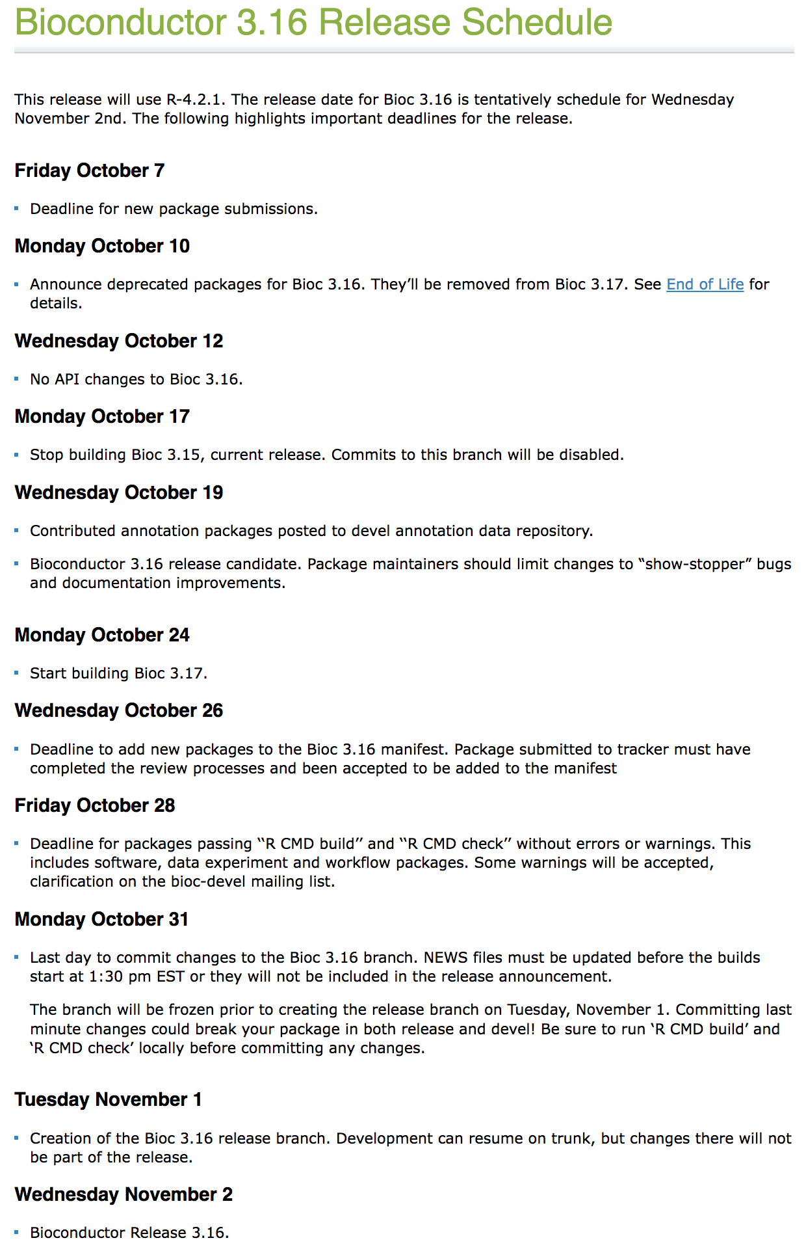
Bioconductor version
Transition Bioc 3.16 (devel) -> Bioc 3.17 (devel) done on Nov. 2

Slide 36
Installation of Bioconductor packages
Bioconductor packages are on Bioconductor, not CRAN
So you install them using Bioconductor’s BiocManager!
BiocManager::install("Biostrings")
BiocManager::install(c("GenomicRanges”, "rtracklayer"))

Slide 37
Bioconductor essentials
GRanges (through GenomicRanges package)
XNAStrings (through Biostrings)
Import/export from/to common genomic files with import() and export() (through rtracklayer package)

Slide 38
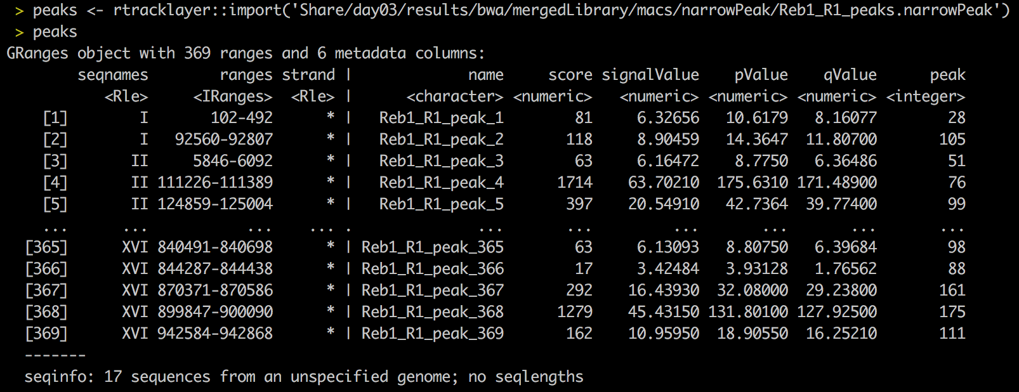
GRanges
Workhorse class of Bioconductor
Used to describe genomic intervals or ranges

Slide 39
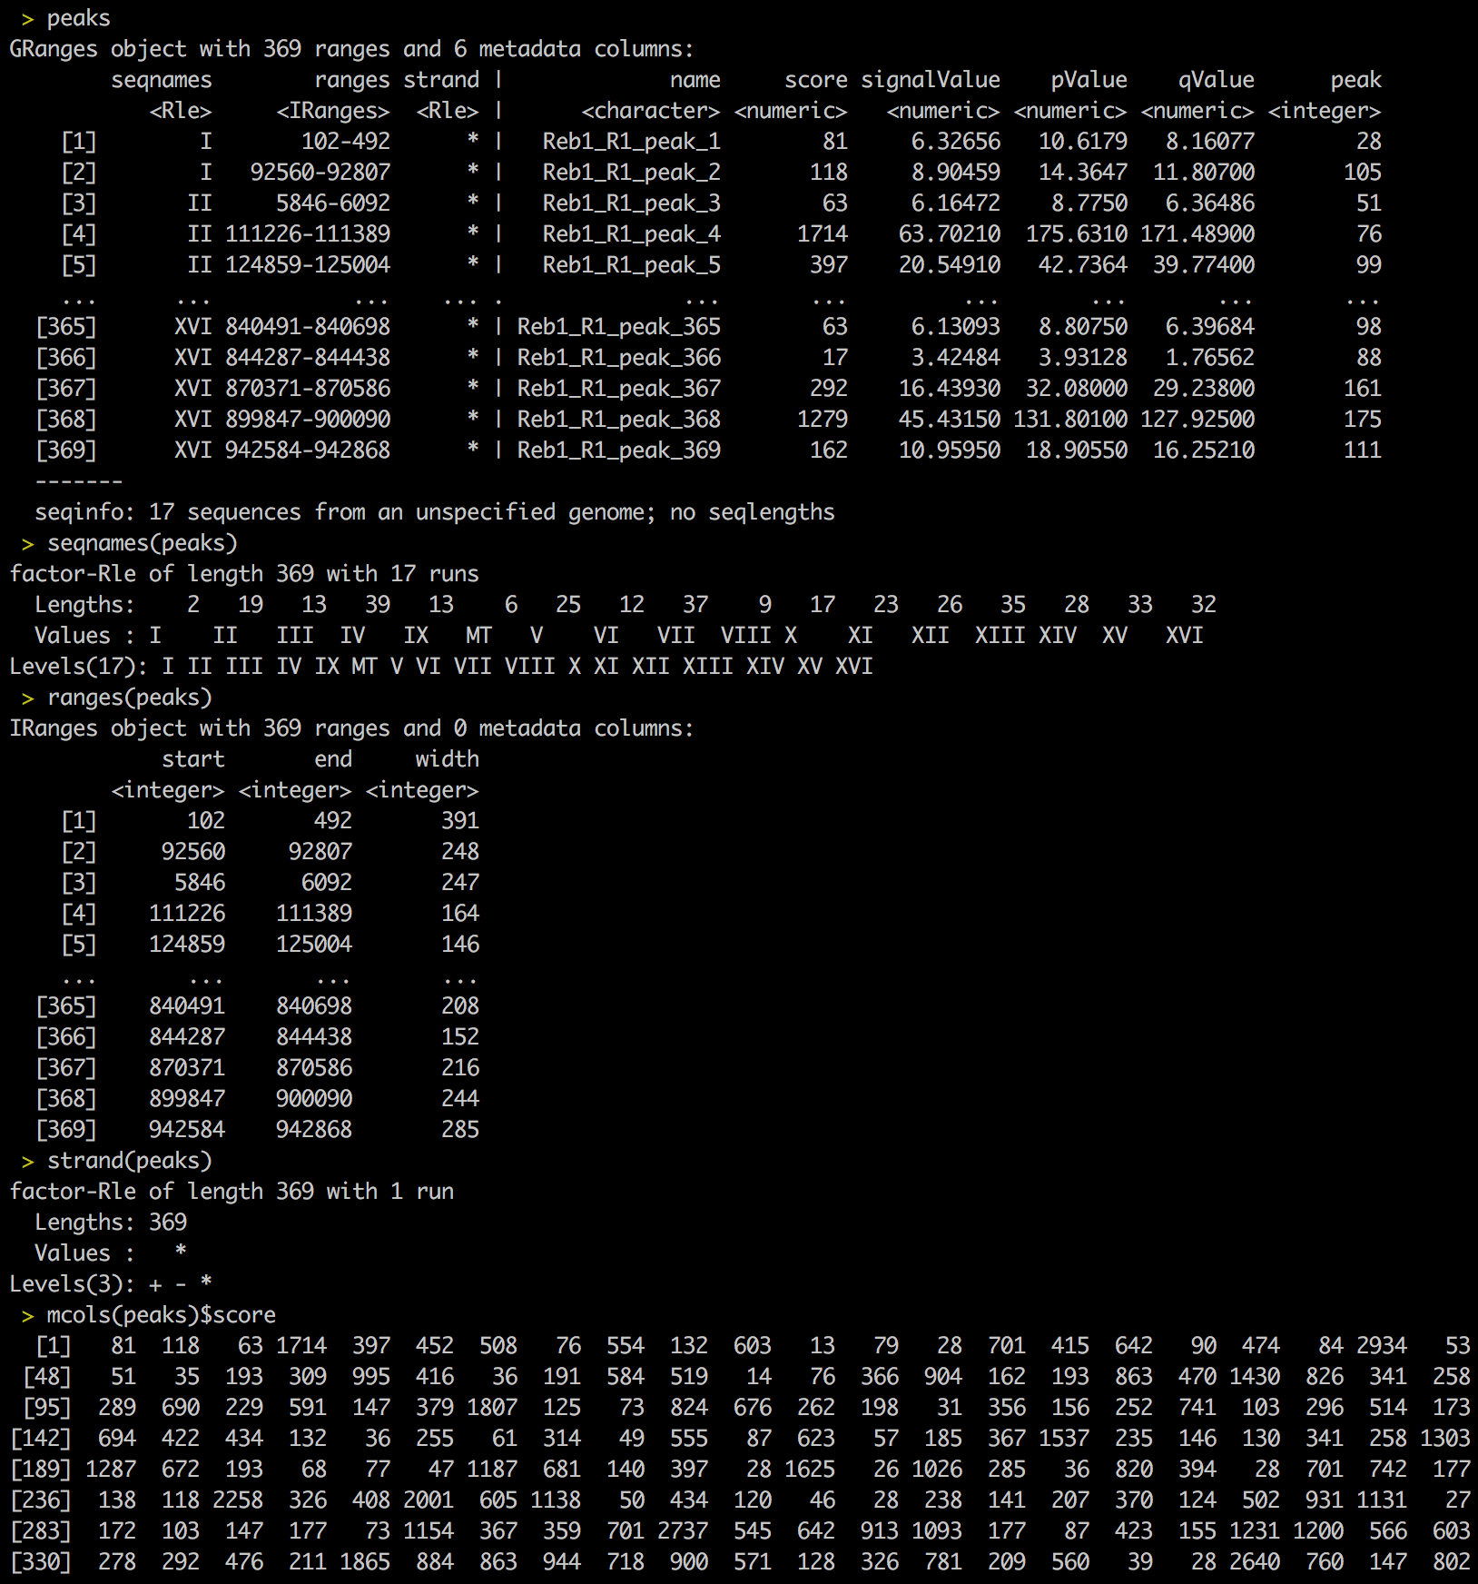
GRanges
Getter functions
seqnames() → chromosome
ranges() → location
strand()
start()
end()
width()
mcols(…)$... → metadata
…$... → metadata

Slide 40
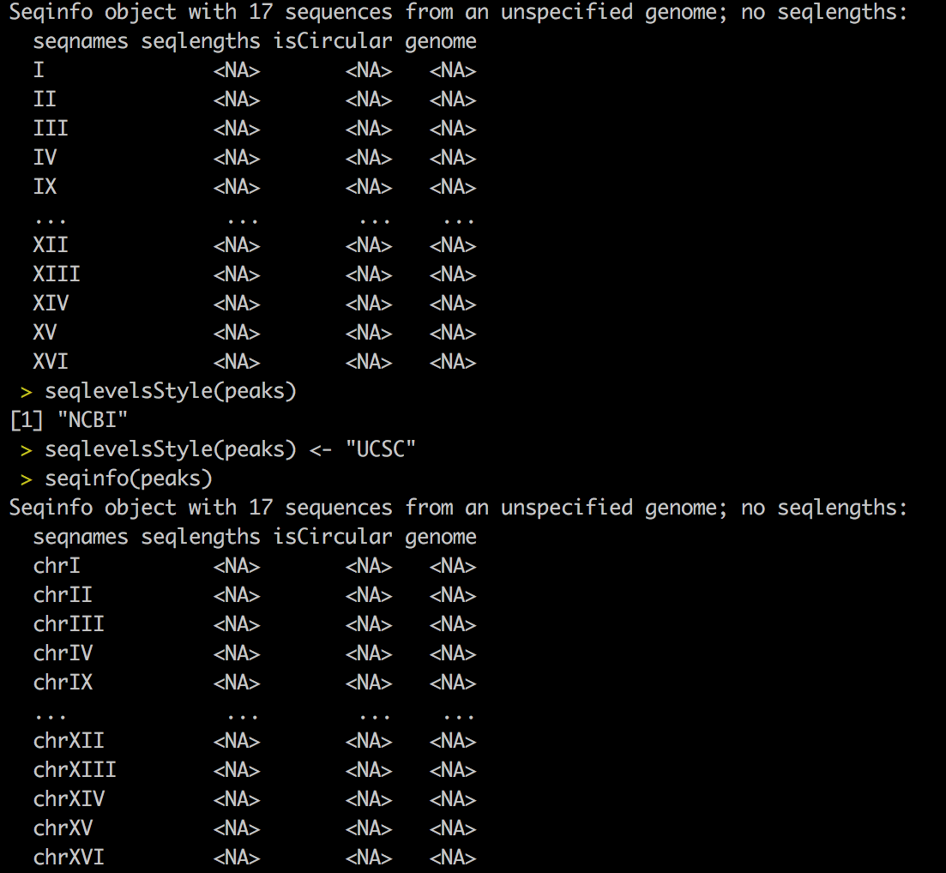
GRanges
Genome information
seqinfo()
seqlevelsStyle()

Slide 41
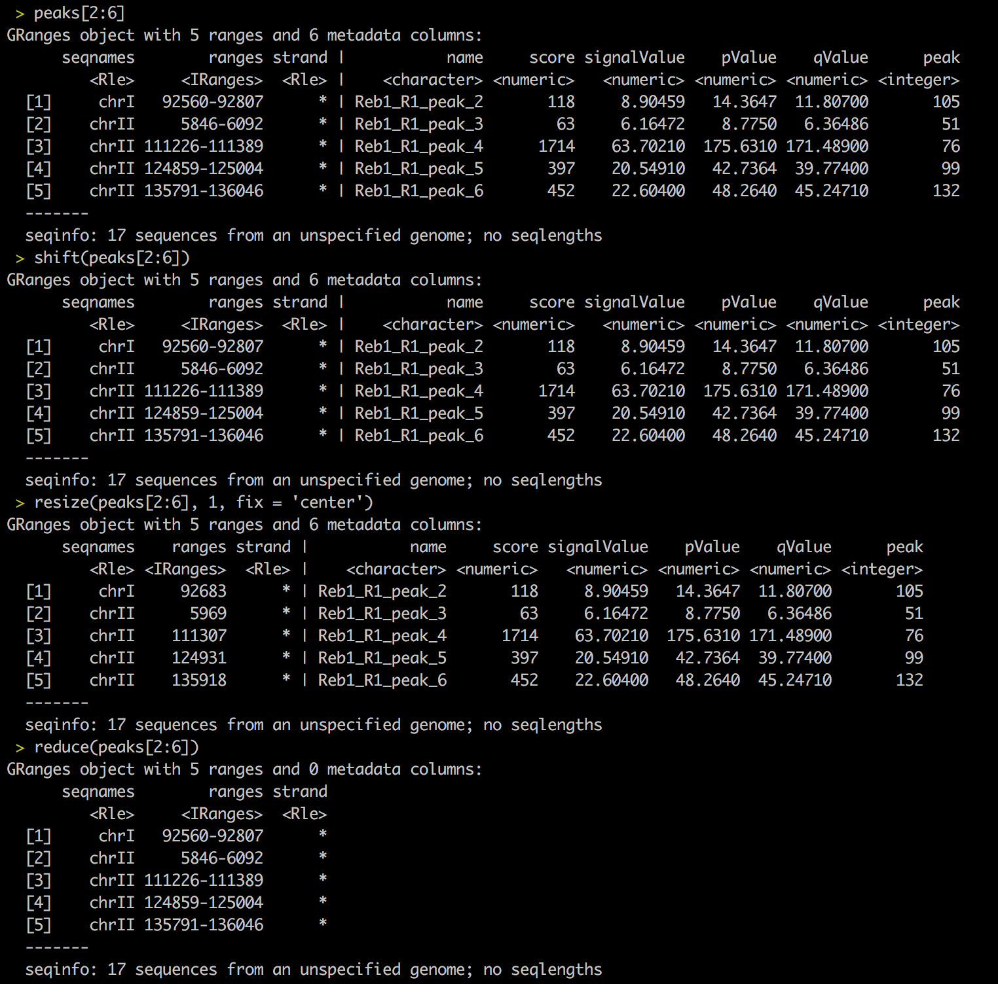
GRanges
Action functions
…[…] (to subset)
shift()
resize()
reduce()
coverage()
…

Slide 42
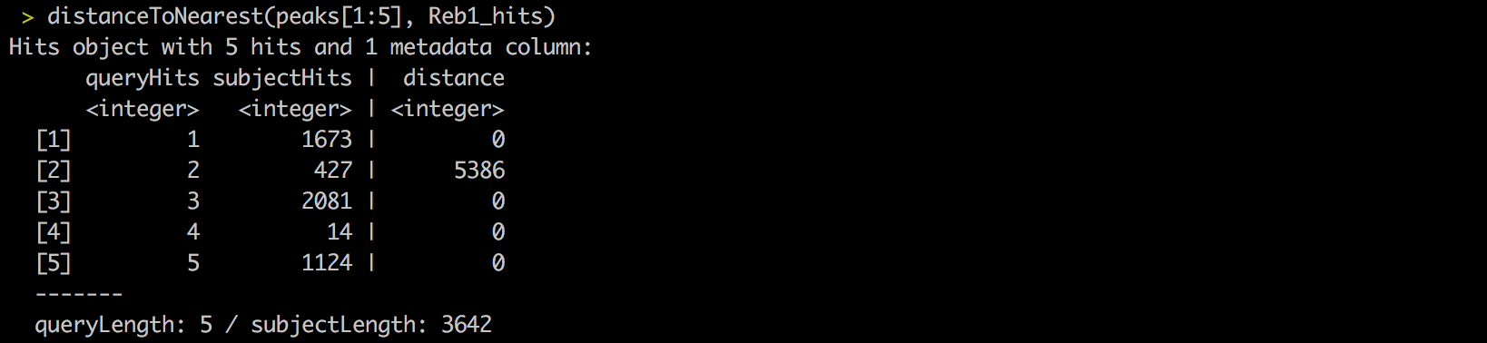
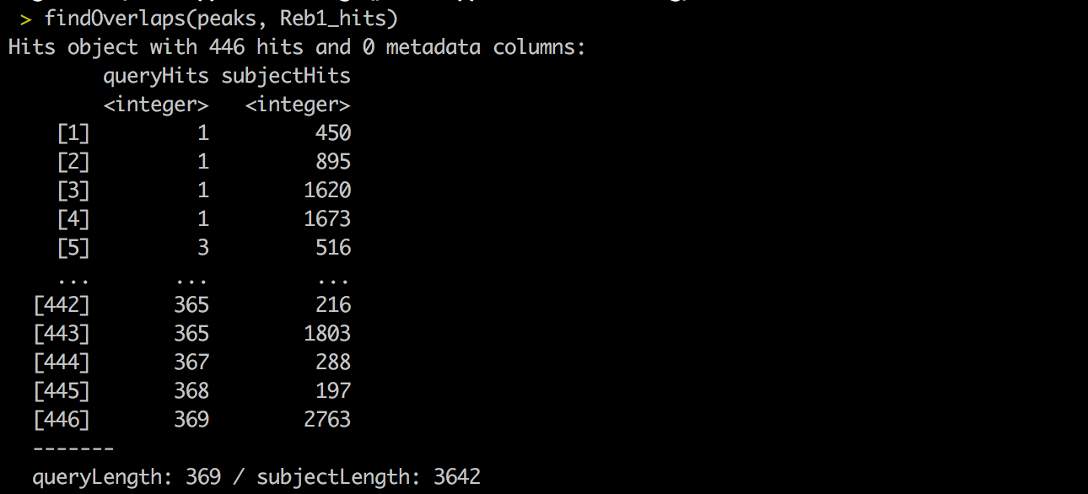
GRanges
Comparison functions
%over%
distance()
distanceToNearest()
findOverlaps()
subsetByOverlaps()

Slide 43
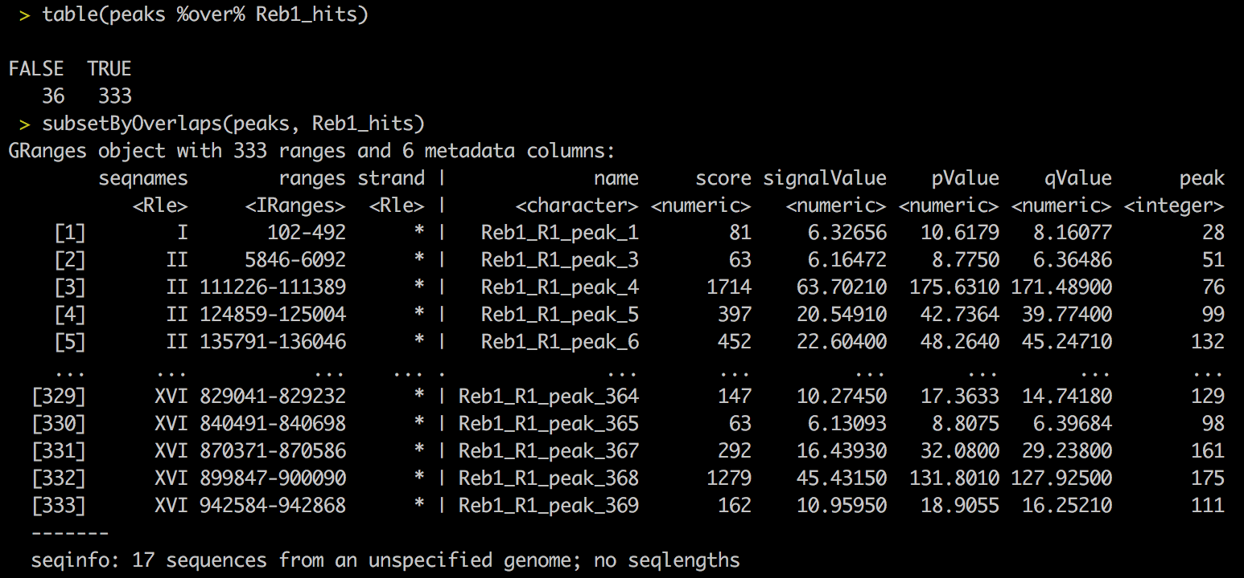
GRanges
Comparison functions
%over%
distance()
distanceToNearest()
findOverlaps()
subsetByOverlaps()

Slide 44
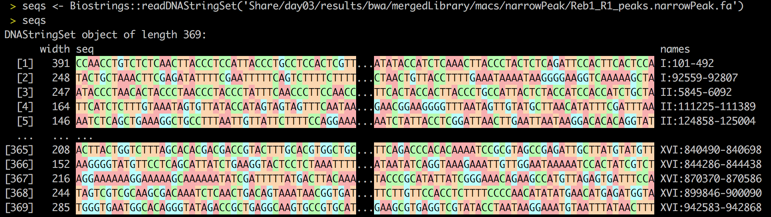
Biostrings
Biostrings in R

Slide 45
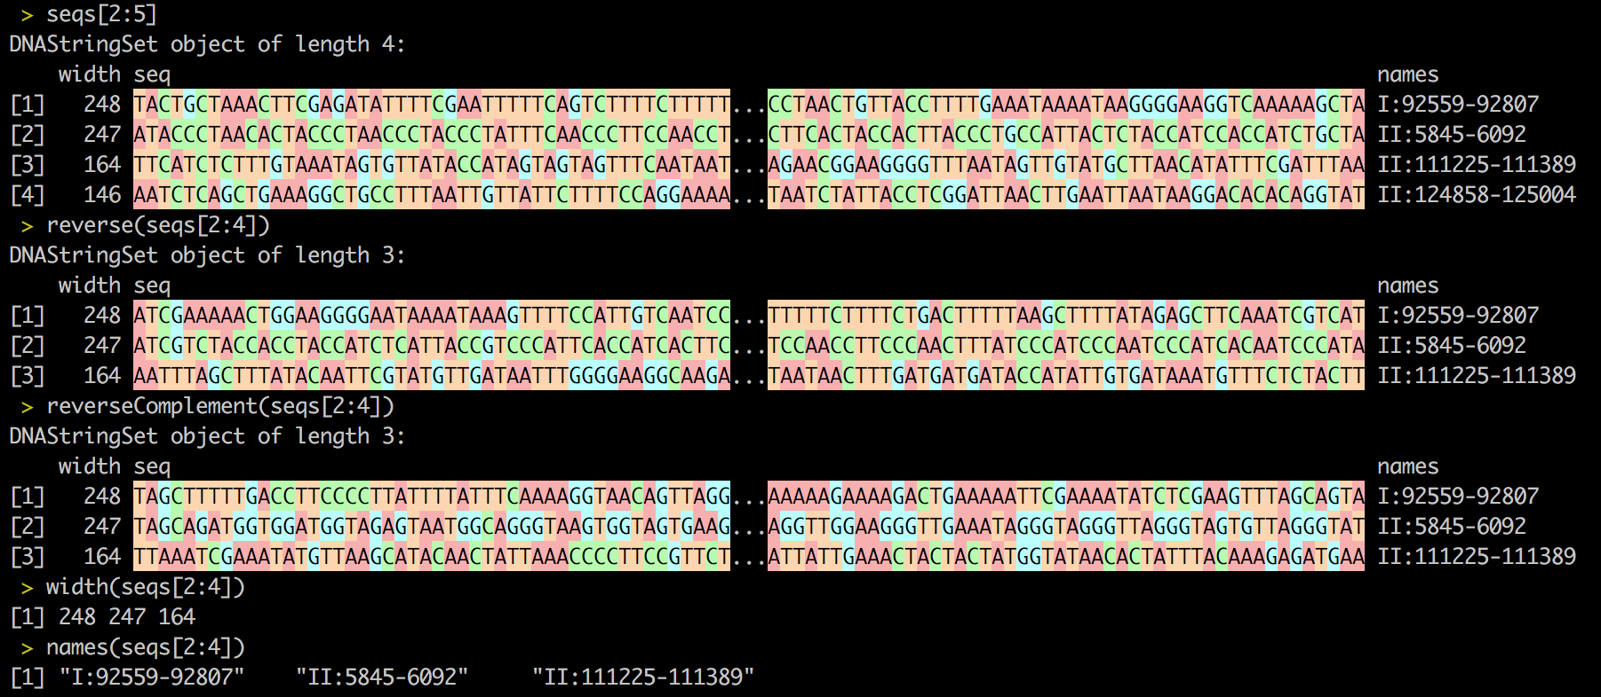
Biostrings

